Slide 1

Data Design Class #1
Unrelated Transforms
Mike Acton 29 Mar 2010

Slide 2
What is an unrelated transform?
Source data
Transforms
Destination data

Slide 3
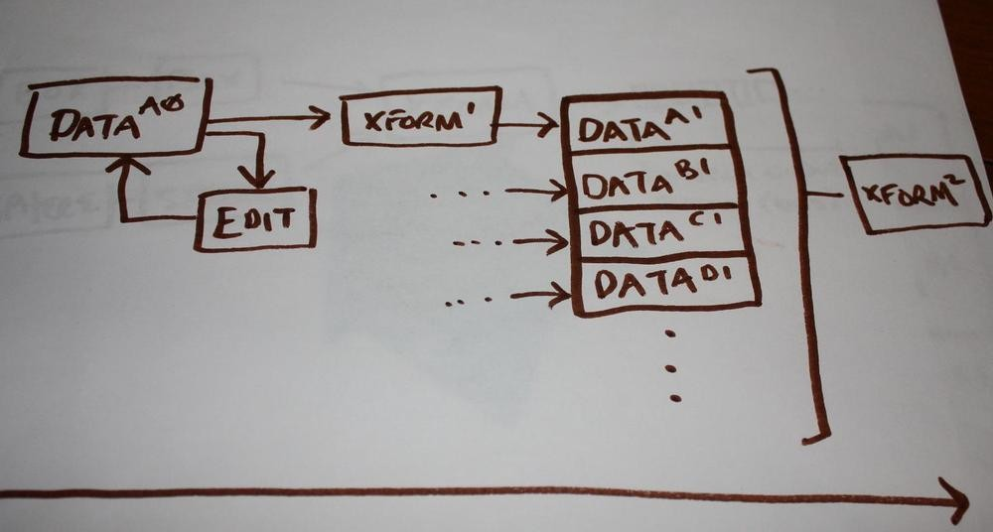
Solving
related
transforms
is
intuitive
Data design fundamental: Two different problems imply two different data designs.

Slide 4
Implication: Transform equality
Not all transforms are equal!
•
•
•
•
•
Throughput requirements (call
Latency requirements
Data access
rate)
Transform is always paired with input
output data
and

Slide 5
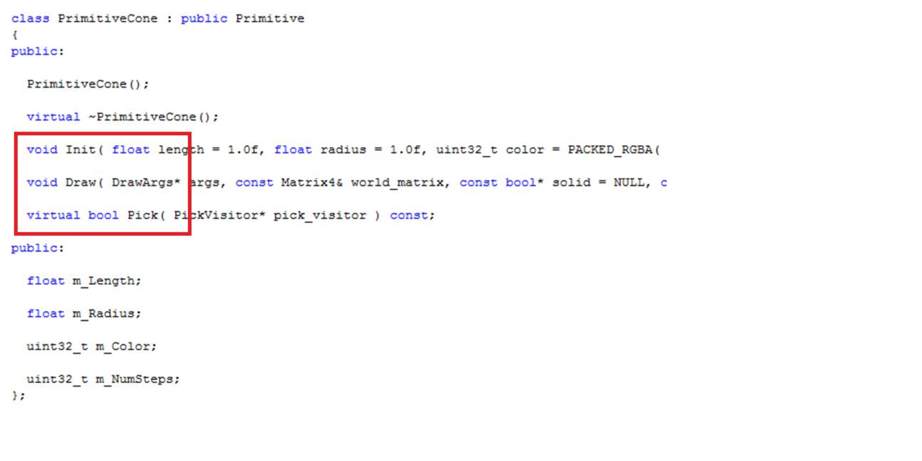

Slide 6
Implication: Spaghetti
data
•
•
•
•
•
•
Much worse than spaghetti
Unclear access patterns
Unnecessary locking
DCache thrashing
The reason why cache sizes
No statistical relationship
code!
are bloated
in
h/w

Slide 7
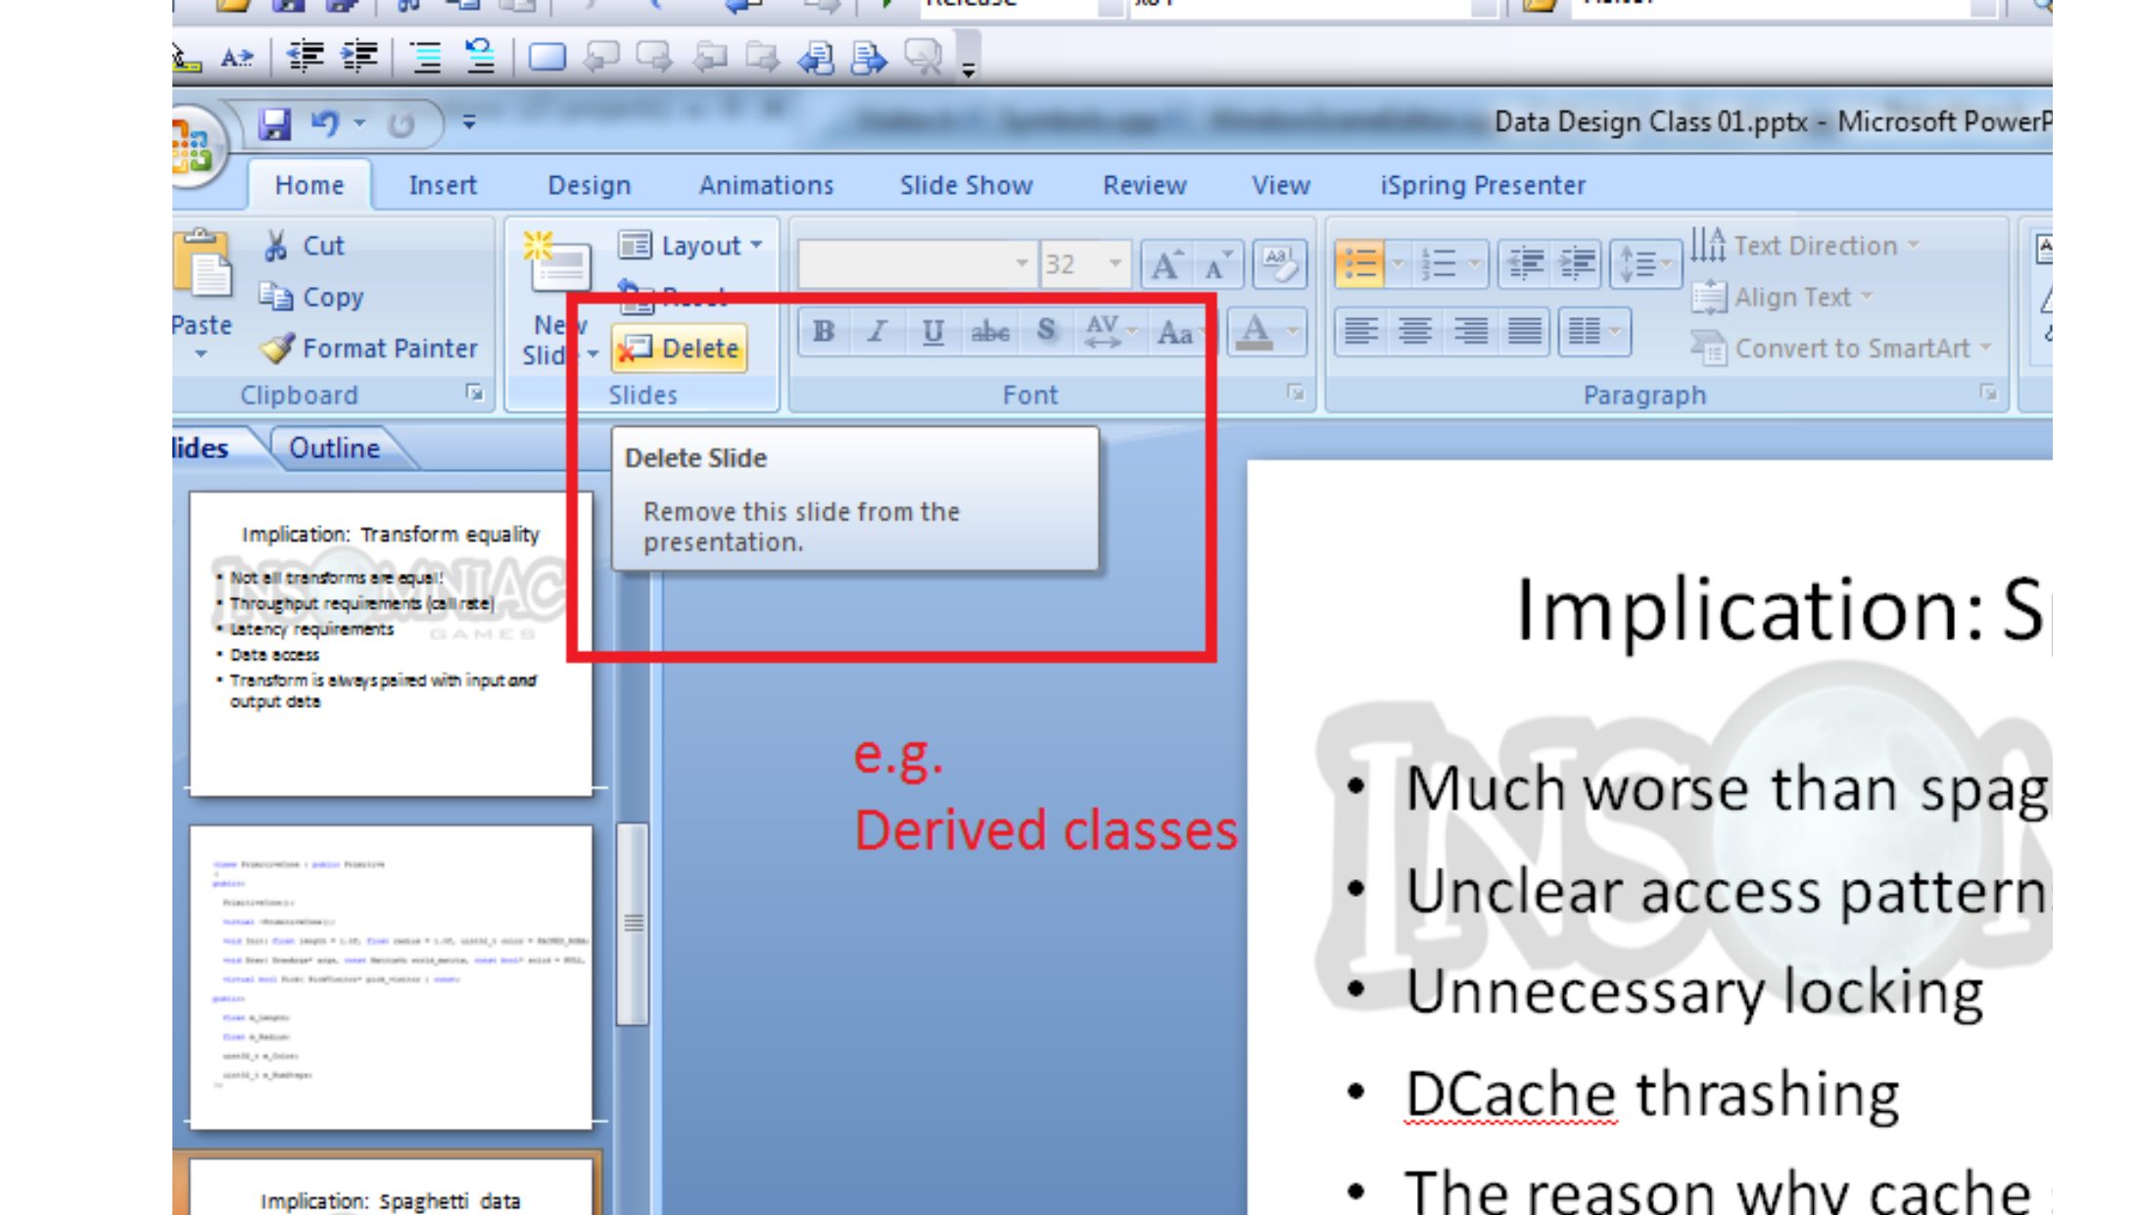

Slide 8
Implication: Monolithic
Poor memory characteristics Unknown usage patterns Transactions unclear
structs
•
•
•

Slide 9
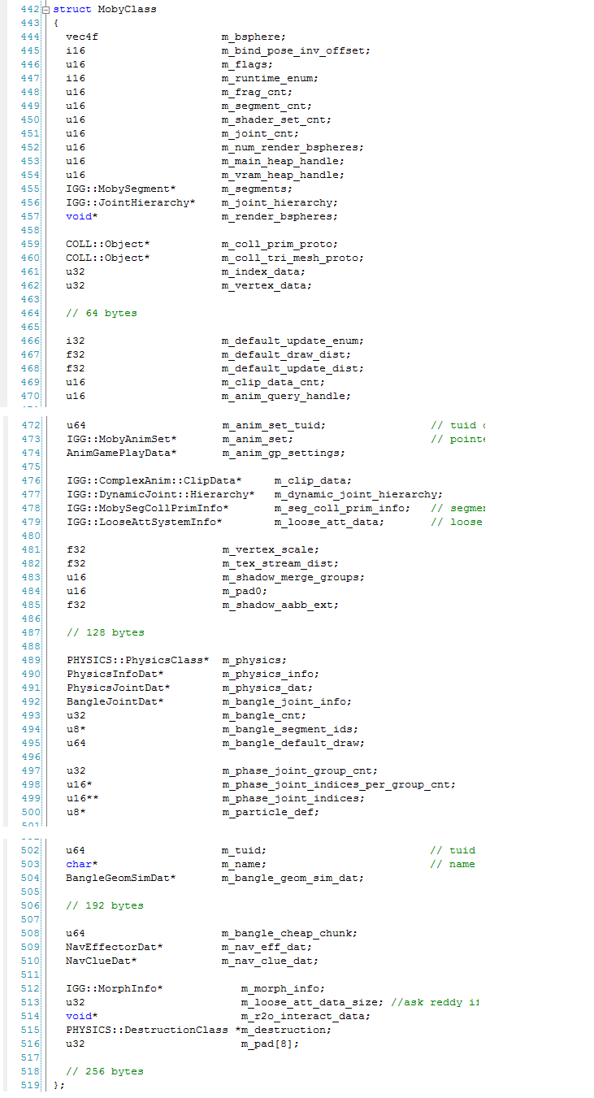
MobyClass
Note: Compare components

Slide 10
Implication: Classification flags
Need to distinguish cases
A lot of additional implicit state machines
Unnecessary checks/tests
Additional points of failure
Nonsense combinations
•
•
•
•
•

Slide 11
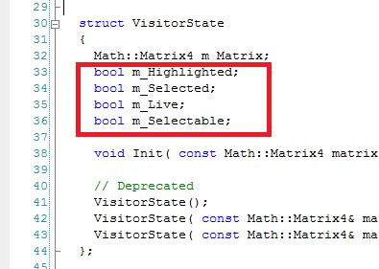

Slide 12
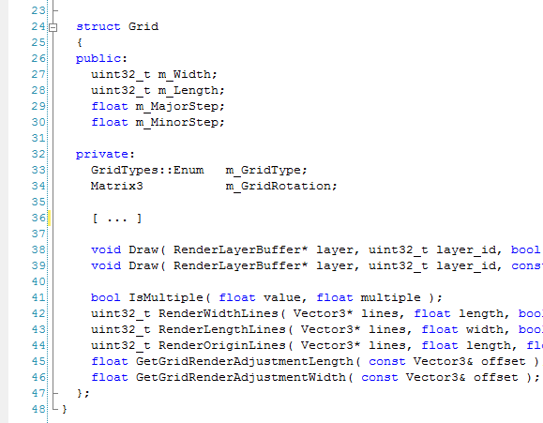

Slide 13
Implication: Unnecessary virtuals
Asking the wrong question:
Don’t ask: “What does this do?”
Ask: “What am I doing with this data?”
•
•
•

Slide 14
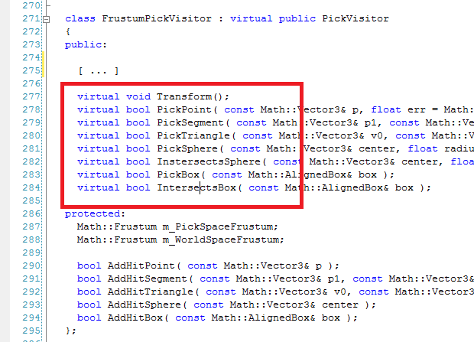

Slide 15
Implication: Unoptimizable
Obvious: Global optimizations more valuable
than local ones.
Data not organized on global access patterns
can’t be globally optimized.
•
•

Slide 16
Implication: Poor concurrency
Short answer: Can’t.
Typical solution must enforce sequence.
– i.e. Over-locking
•
•

Slide 17
Implication:
Bears repeating:
Code
>
Data
•
–
–
–
We do not write code.
We transform data.
Code is a tool to do that.

Slide 18
Discussion Topic
“Visitor Pattern”

